Slide 1
NAME: SOWMITHRAN S NM-ID: au711721243104 7117- KGiSL Institute Of Technology
Color-Based Hand Motion Recognition with OpenCV
3/21/2024 Annual Review

Slide 2
PROJECT TITLE
AIR CANVAS - Color-Based Hand Motion Recognition with OpenCV
3/21/2024 Annual Review

Slide 3


AGENDA
Problem Statement.
Project Overview.
End Users.
Our Solution and Proposition.
Key Features.
Modelling Approach
Results and Evaluation
3/21/2024 Annual Review

Slide 4

PROBLEM STATEMENT
The challenge lies in developing a real-time system that can track hand movements without relying on complex shapes or specialized hardware. This project aims to achieve this by utilizing OpenCV and Python to analyze color variations within a live video stream.
3/21/2024 Annual Review

Slide 5

PROJECT OVERVIEW
Hand motion recognition is a fundamental aspect of human-computer interaction, with applications ranging from virtual reality gaming to sign language translation. This project utilizes the power of OpenCV, a popular computer vision library, to detect and track hand movements based on predefined color thresholds.

Slide 6

WHO ARE THE END USERS?
The primary end users for this application are presenters who want to incorporate a more dynamic and interactive element into their presentations. This could include
Business Professionals: They can use it to create engaging presentations for clients, colleagues, or investors.
Educators: Teachers, lecturers, and professors can leverage it to explain concepts in a visually stimulating way, fostering student engagement.
Trainers and Workshop Leaders: They can use it to create interactive workshops where participants can contribute ideas by "writing in the air.“
YouTubers and Content Creators: This can be a unique tool to visually explain concepts in their videos, increasing audience retention.

Slide 7

YOUR SOLUTION AND ITS VALUE PROPOSITION
Value Proposition
Enhanced audience engagement: Move beyond static slides and capture attention with dynamic writing that appears as you move your hand.
Improved information retention: Visual elements and interaction can enhance audience focus and understanding of key points.
Increased presenter control: Emphasize important information through hand gestures like underlining or circling.
Creative freedom: Illustrate concepts with drawings or diagrams directly on the screen, fostering a visually stimulating experience.
Cost-effective and accessible: Leverages free and open-source tools (Python, OpenCV) for a budget-friendly solution.

Slide 8

THE WOW IN YOUR SOLUTION
Imagine this: Captivate your audience by literally writing in the air Ditch the clicker and projector dance – presentations just got a futuristic upgrade.
Real-time magic: Watch your ideas come alive on screen as you move your hand. It's like having a digital whiteboard that follows your every gesture.
Engagement amplified: Forget passive slideshows. This tool transforms presentations into interactive experiences, keeping your audience hooked and participating.
3/21/2024 Annual Review
8

Slide 9
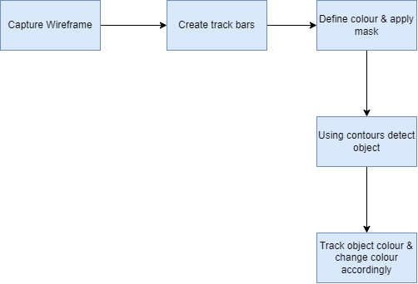
MODELLING
9

Slide 10
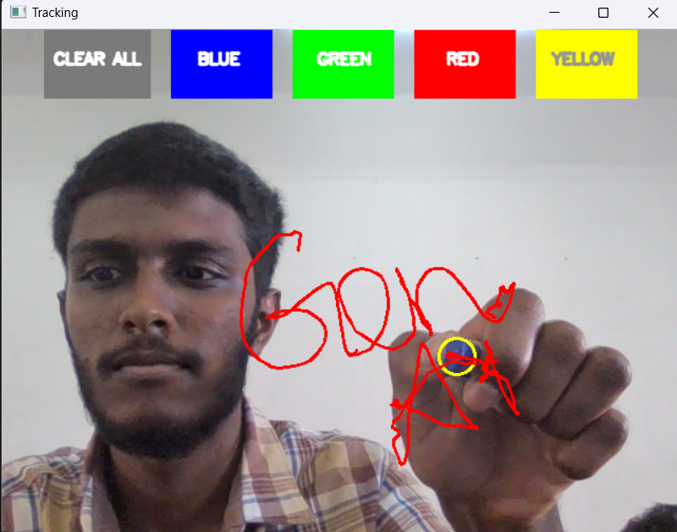
RESULTS
Color-based hand motion recognition is a technique used in computer vision to track the motion of a hand in an image or video sequence. It works by identifying pixels in the image or video that correspond to the color of the hand. The location of these pixels can then be tracked over time to determine the motion of the hand.
Demo Link
10

